Slide 1
VirtualPersistAPI
Final project for WEBLAMP 443
by Paul Mitchum

Slide 2
What Is VPA?
VirtualPersistAPI is a RESTful data storage API.
POST, GET, DELETE to URI:
/endpoint/uuid/category/key
/api/6d286553-59ae-409a-887d-ee75df67b834/someCategory/aKey
UUID represents the user.

Slide 3
Why is VPA?
VPA exists to allow people using virtual worlds to store data outside the virtual world system using http requests.
VPA can be general-purpose, but is designed with Second Life as a specific use-case.
Second Life avatars are identified by UUID.
Live demo?

Slide 4
VPA Architecture
Symfony2
Doctrine2
- ORM: Object Relational Mapper
- DBAL: DB Abstraction Layer
PHP in a LAMP stack.
SQLite for testing.

Slide 5
VPA Project Requirements:
Easy to support
Easily deployable

Slide 6
Class Project Requirements:
- Transactions
- Debuggging
- Metrics
- Triggers
- Stored Routines
- Functions
- Procedures
- Cursors
- Views

Slide 7
Transactions in Doctrine
Three types of transaction management in Doctrine:
Implicit: Transactions are managed by ORM.
Explicit: Force isolation through DBAL.
EZ Explicit: $em->transactional(\Closure) shorthand.

Slide 8
Transactions (cont.)
In Doctrine, use DBAL to set isolation level for a number of transactions.
$entityManager
->getConnection()
->setTransactionIsolation(
Connection::TRANSACTION_SERIALIZABLE
);

Slide 9
Transactions (cont.)
Doctrine ORM can also lock at the entity level, for read or write:
EntityManager#find(
$className,
$id,
LockMode::PESSIMISTIC_READ)
Imposes SELECT .. FOR UPDATE

Slide 10
Debugging
Symfony2 provides a profiler and exception stack trace.
Response can be modified to include debug info in header. Ideally factored into Response class.
$reqDebug = $request->query->get('debug', 0);
if ($reqDebug) {
$response->headers->set(
'X-VPA-Debug', 'Some debuggy info.', TRUE);
}

Slide 11
Debugging (cont.)
Symfony2 also provides a profiler. Using a profiler token you can retrieve profile info for a request. The token is revealed in an X-Debug-Token header.
X-Debug-Token: de3200
This can be assembled into a URL:
http://example.com/_profiler/de3200

Slide 12
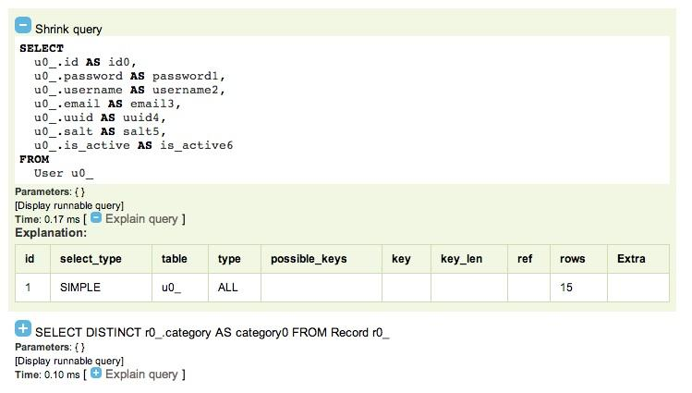
Debugging (cont.)
The profiler gives you a great deal of information, including a profile of all the Doctrine-related SQL queries.

Slide 13
Views
Doctrine2 doesn't support views.
Doctrine1 did.
Relatively easy workaround:
use Doctrine\ORM\Query\ResultSetMapping;
Inform Doctrine of which result columns refer to entities it manages.

Slide 14
Views (cont.)
$rsm = new ResultSetMapping;
$rsm->addEntityResult(
'VirtualPersistBundle:Record', 'r');
$rsm->addFieldResult('r', 'id', 'id');
...

Slide 15
Views (cont.)
Views downsides:
* Deployment is a hassle.
* My use case only uses the view as a prefabricated JOIN, so not worth the pain.
* Not natively supported by Doctrine2.
* Entity mapping only works for one entity type.

